Slide 1
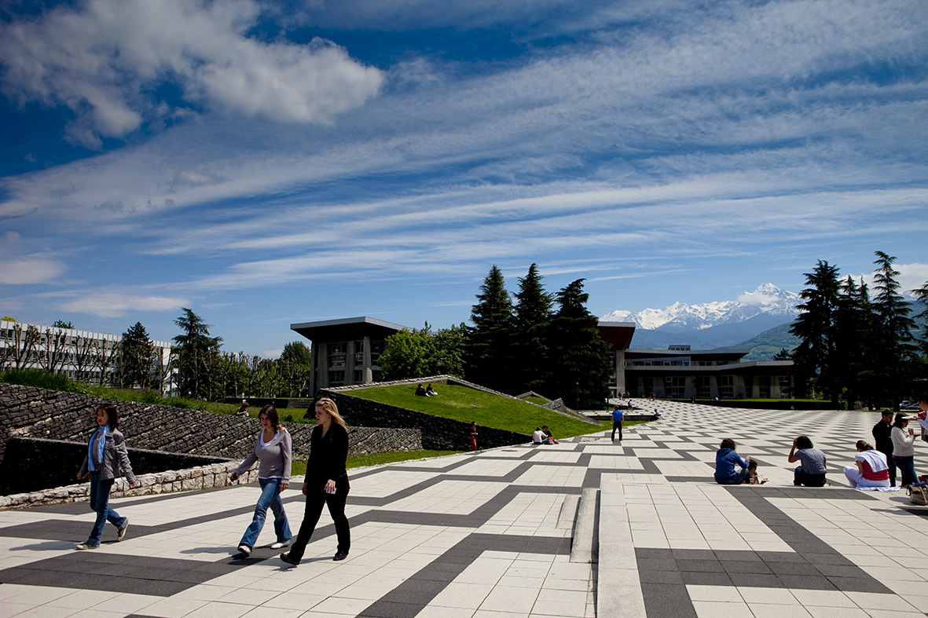
COMPUTER RESSOURCES UFR IM²AG - 2022-2023

Slide 2
IT department: permanence and assistance
IT department permanence for students: room 207a
Monday: 9:00-12:30 / 13:30-18:30 Tuesday to Thursday: 8:00-12:30 / 13:30-18:30 Friday: 8:00-12:30 / 13:30-17:30
Out of hours:
Mail to im2ag-service-informatique@univ-grenoble-alpes.fr
Open a ticket: https://im2ag-incidents.univ-grenoble-alpes.fr
2

Slide 3
IM2AG Wiki
You can find a lot of useful information on our Wiki:
https://im2ag-wiki.univ-grenoble-alpes.fr
About computer ressources
Printing
How to connect to IM2AG computer ressources from home
Documentation about videoconference tools
Technical details for computers or softwares, etc.
3

Slide 4
Lab rooms
UFR IM2AG has 22 lab rooms, mainly at 2nd floor of F building.
Operational hours: 7:30 – 18:30 from Monday to Friday
You can freely use lab rooms during the day if there are no scheduled courses.
Self service room: F021
Access with student card from October to July
Opened everyday from 18:30 to 21:00
Please, never unplug anything in lab rooms. Only use free power plugs.
For wired network, you can use the red RJ45 cables only: once connected, you will be redirected to a login portal. Use yourlogin@cuga and your password as credentials.
4

Slide 5
UGA Accounts
For UGA students :
You will have a UGA account when your registration is complete
To get your credentials, follow the instructions on your scholarship certificate
Your UGA account will be synchronized at INP within 24h after activation
Only use UGA dashboard to change your password, and it will be synchronized at INP within 24h
https://leo.univ-grenoble-alpes.fr is the UGA student portal. You will find here a lot of information and links: access to webmail, scheduling, password change, etc.
For INP students :
You will have a INP account when your registration is complete
Your INP account will be synchronized at UGA within 24h after activation
Only use INP dashboard to change your password, and it will be synchronized at UGA within 24h
5

Slide 6
Accounts - During the first month
Some of you will have to use the computer resources for labs before having an official account.
If it’s the case, please request a temporary account to your teachers or to the IT department. A temporary account is personal and must not be shared, you are legally responsible for its use.
Temporary accounts will give you access to IM2AG computers and servers, but not to:
UGA common resources (mail, printing, etc.)
INP common resources
Pedagogic platforms: Moodle, Alfresco, etc.
Temporary accounts are just here to help you before having an official account. Once you have an official account, stop using the temporary one because it will be automatically deleted.
6

Slide 7
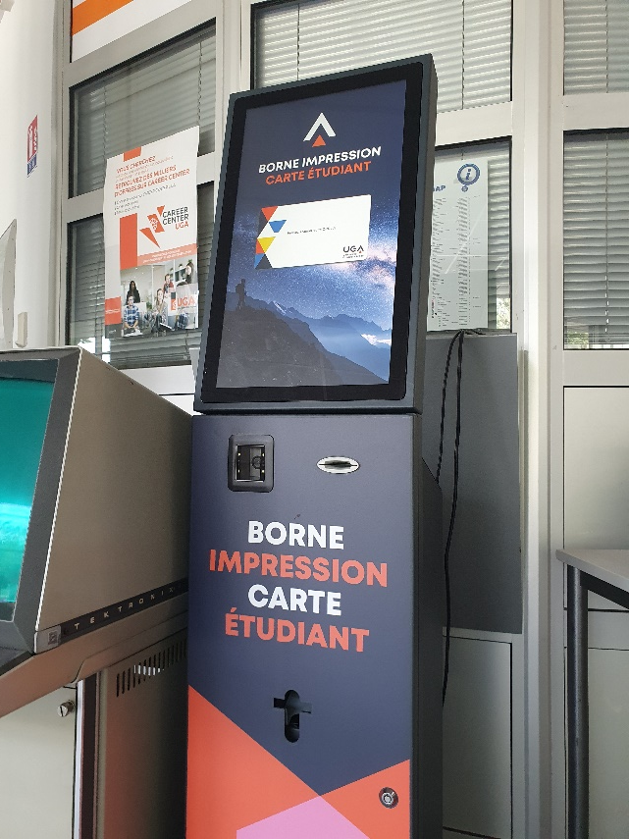
Student card (for UGA students)
To get your student card, there is an automated kiosk in the hall of the F building, next to the scholarship office.
To print your student card, you have to scan the QR-Code from your scholarship certificate, then follow the on-screen instructions.
This QR-Code will also be needed if you lose your student card, so be sure to keep it safe !
6

Slide 8
UGA Webmail
To access to your university mailbox, connect on:
https://leo.univ-grenoble-alpes.fr
You will find a link to your webmail on the dashboard.
On LEO, at the top right corner, by clinking on your name, it is possible to make a redirection from your university mailbox to your personnal email address.
Please note that it is not possible to access to university email address with POP/IMAP clients, you must use the webmail or make a redirection to another email address.
7

Slide 9
Home directory at IM2AG
Each UGA account have 10 Gb of storage.
Accessible from everywhere at IM2AG:
Windows: on network drive named Z:\
Ubuntu and pedagogic servers: directory named /u/ or /home/
Autosaves accessible under /u/.snapshots/ directory:
1 weekly save
6 daily saves
8

Slide 10
Printing
One printer is available at the 2nd floor: you can print from the computers with the printer named “IMPRESSION_UGA”.
When your print is sent to the printer, it will not be printed until you come to the printer and login on the printer screen or with you student card.
Each student have a printing quota, credited one time at the beginning of the year (on October 1st), that can be recharged by credit-card if needed, using the following link: https://impression.univ-grenoble-alpes.fr
The printer can also be used to make copies: you can print the copied document (which uses your printing quota) or send it to your UGA email address in PDF format (which is free and unlimited).
9

Slide 11
WiFi access
SSID: wifi-campus
Access from all places on the campus
First way of connection: captive portal (for web access only)
Connect to the WiFi
Try to access to any webpage with your web browser
You will be redirected to the connection portal
Authenticate with UGA account
Second way of connection: VPN (for web and pedagogic resources)
Connect to any WiFi or LAN network
Follow instructions on http://vpn.grenet.fr to install VPN client
Authenticate with the AGALAN account
Please note that VPN access can also be used from home
10

Slide 12
Time schedule (ADE)
To access your time schedule is you already have an official UGA account :
https://leo.univ-grenoble-alpes.fr
During the first month, if you only have a temporary account, you can access your time schedule via this link :
https://www.univ-grenoble-alpes.fr/formation/admissions-et-inscriptions/candidater-et-s-inscrire/etape-4-emploi-du-temps/
Following this link, you can find a tutorial to synchonize your ADE time schedule with your usual schedule software (Google Calendar, iCal, etc.) :
https://intranet.univ-grenoble-alpes.fr/applications/emplois-du-temps-enseignants/synchroniser-ade-avec-son-agenda-87864.kjsp?RH=1625576331926
11

Slide 13
Useful links
UFR IM2AG website: https://im2ag.univ-grenoble-alpes.fr/
UGA website: https://univ-grenoble-alpes.fr/
ENSIMAG website: https://ensimag.grenoble-inp.fr/
UGA student portal https://leo.univ-grenoble-alpes.fr where you will find:
Links to your email address
Link to the ADE schedule
Account management (password change, etc.)
IM2AG Moodle: https://im2ag-moodle.univ-grenoble-alpes.fr/
ENSIMAG Moodle: https://moodle.caseine.org/
12

